Slide 1
The Journal of Adventist Education
75 Years
Since 1939

Slide 2
Priorities 2010-2015
JAE
Priorities
Adventist Identity & Mission
Disciple Adventist Students
Leader-ship
Mission-Focused Teachers

Slide 3
Priorities 2010-2015
Leadership
Make educational leaders aware of Church-produced resource materials in the four main languages
Mission-Focused Teachers
Provide practical approaches for nurturing spiritual growth
Adventist Identity and Mission
Promote meaningful integration of faith and learning in the various disciplines and a biblical worldview overall
Enhance academic quality
Disciple Seventh-day Adventist Students
Involve all students in the mission of the church through witness and service

Slide 4
Mission
To be the professional publication for Seventh-day Adventist teachers and educational administrators, worldwide.

Slide 5
Scope
Educators from kindergarten through university level

Slide 6
Scope
5 issues per year
Each issue of The Journal features informational and practical articles on a variety of topics relating to Christian education.

Slide 8
Peer Review
Most articles printed in the Journal are peer reviewed, using a double-blind process in which neither the author nor the reviewer are told each other’s identity.

Slide 9
2013

Slide 11
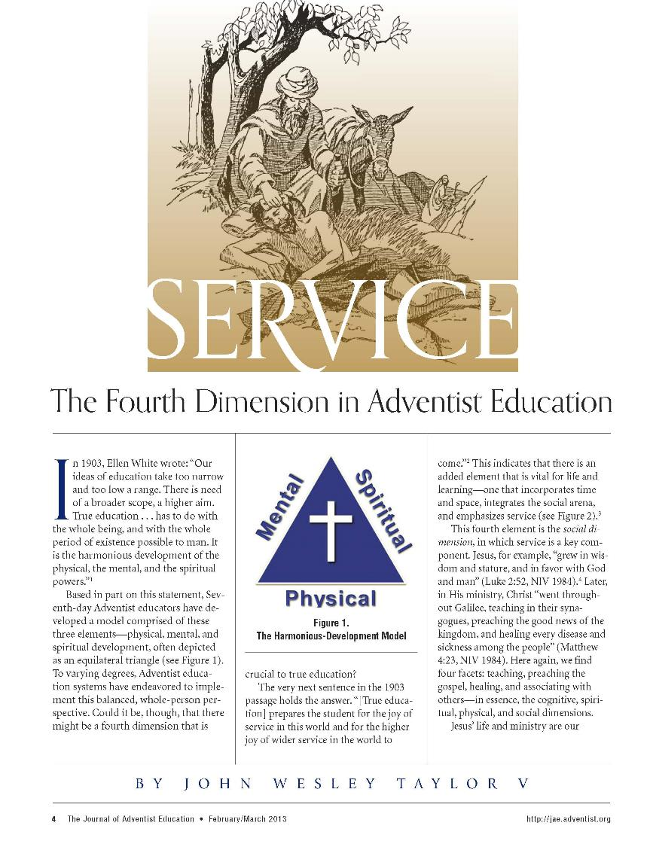

Slide 12
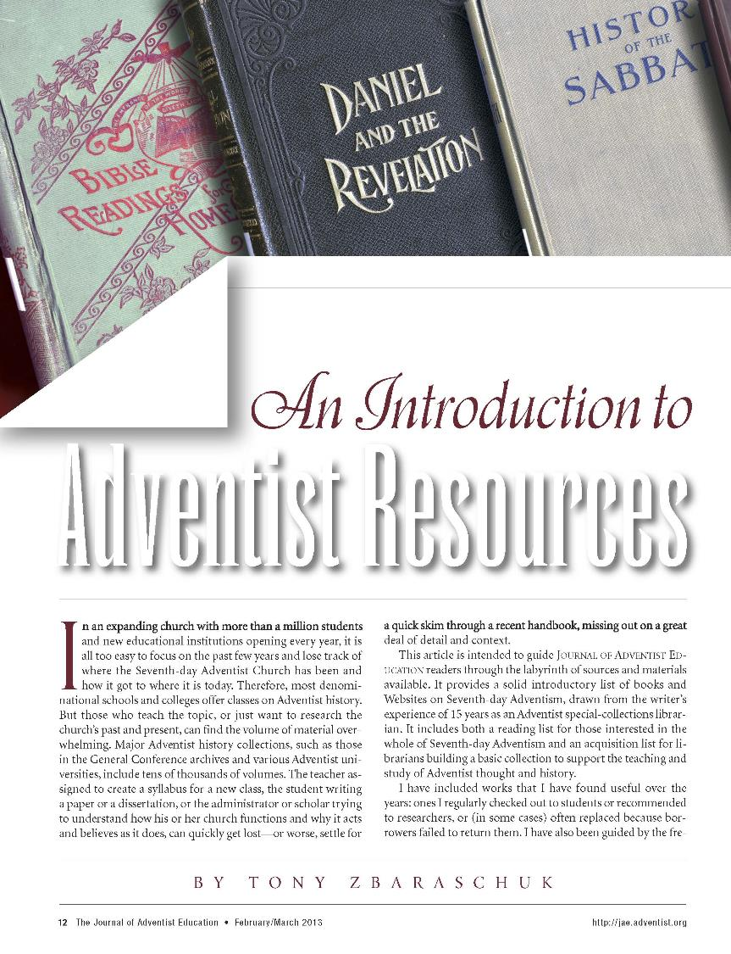

Slide 13
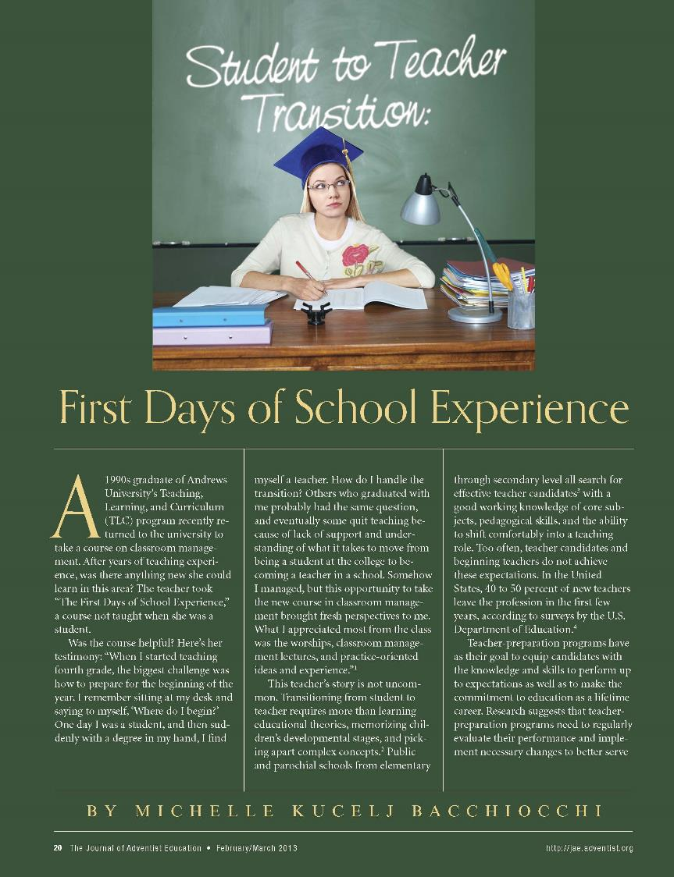

Slide 14
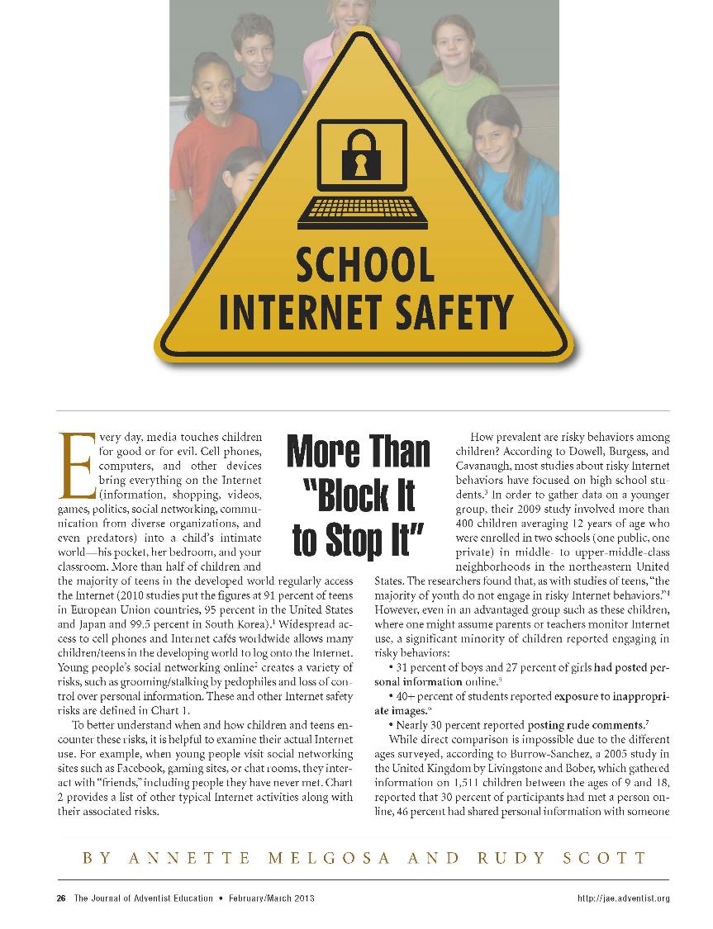

Slide 15
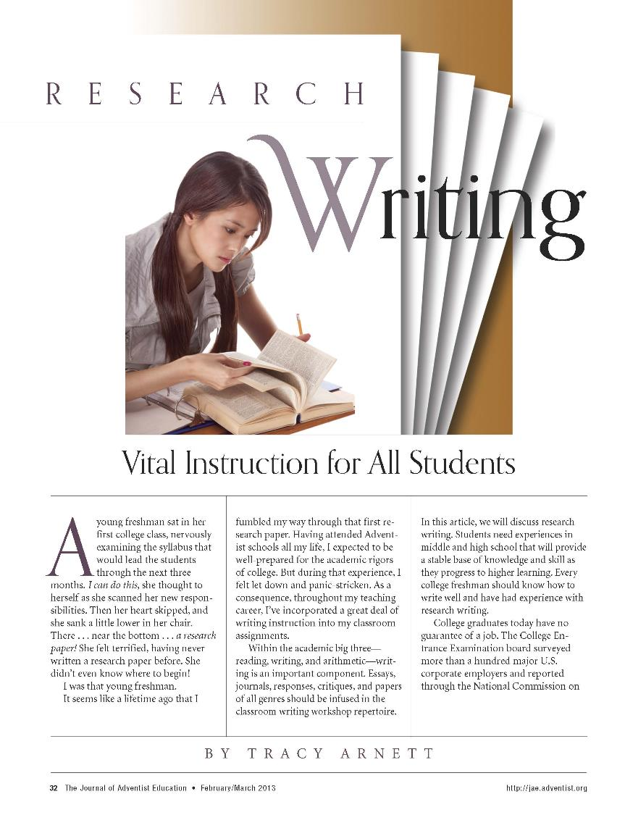

Slide 17
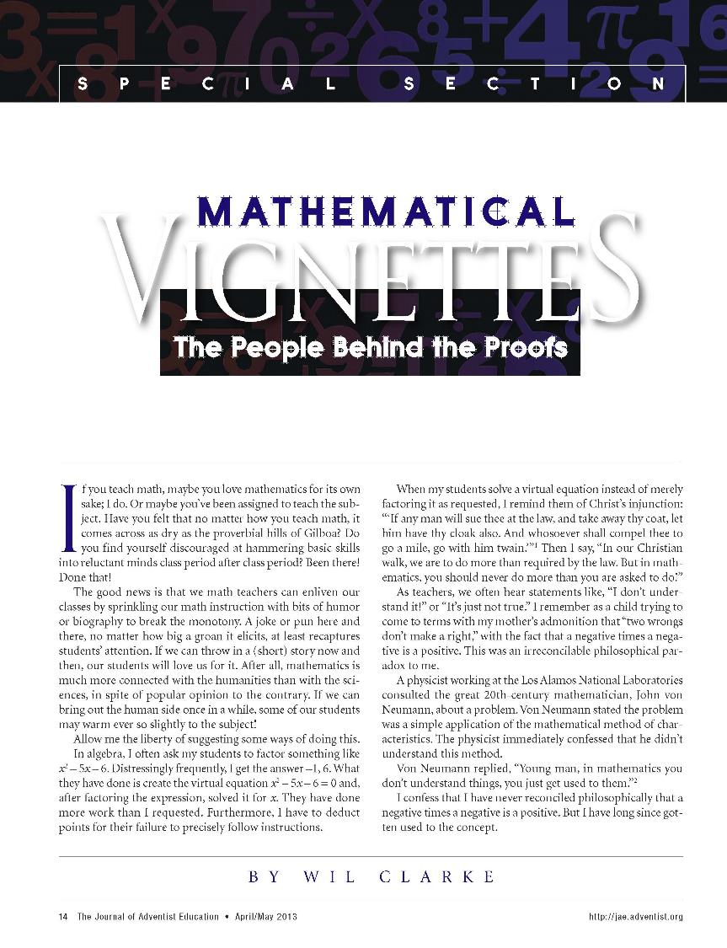

Slide 18
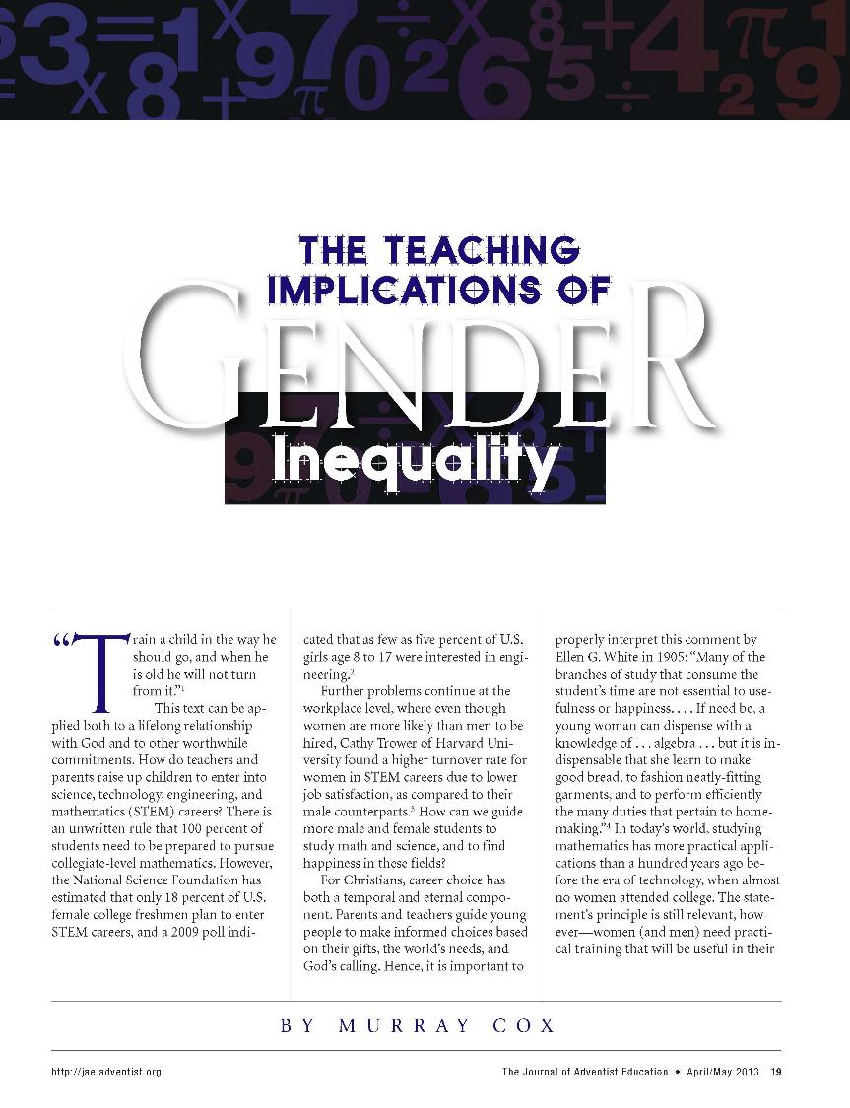

Slide 20
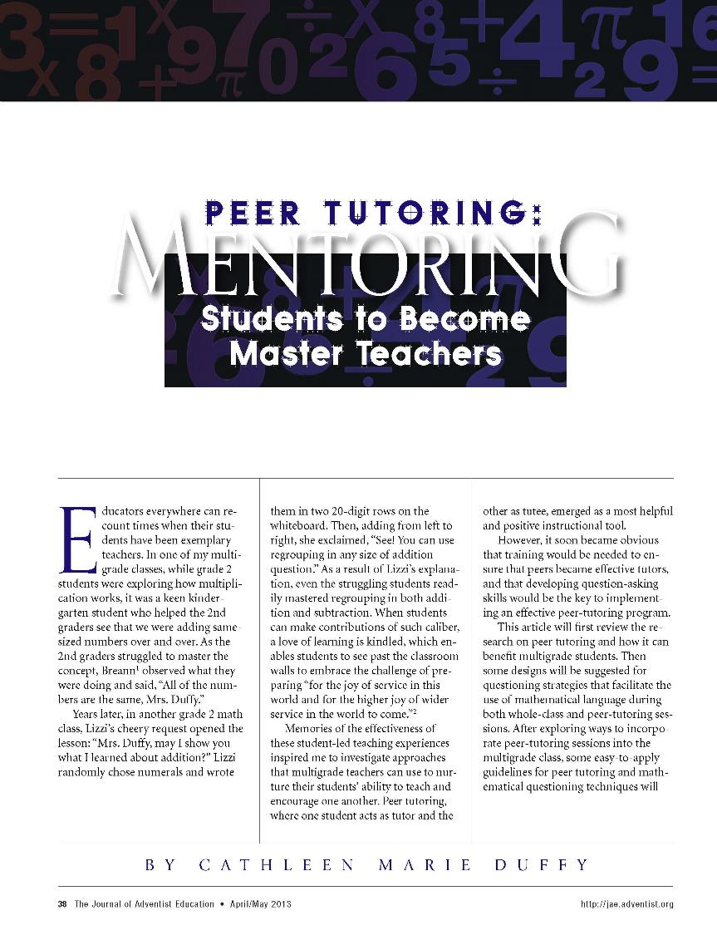

Slide 21
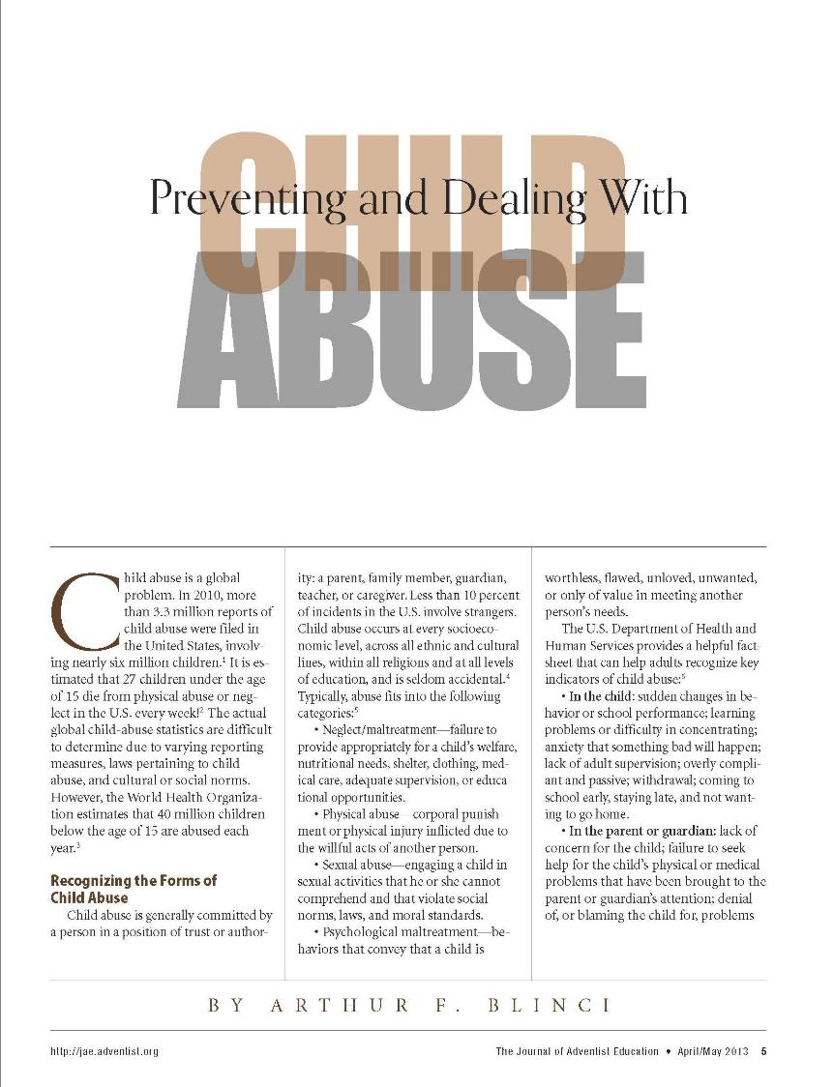

Slide 23
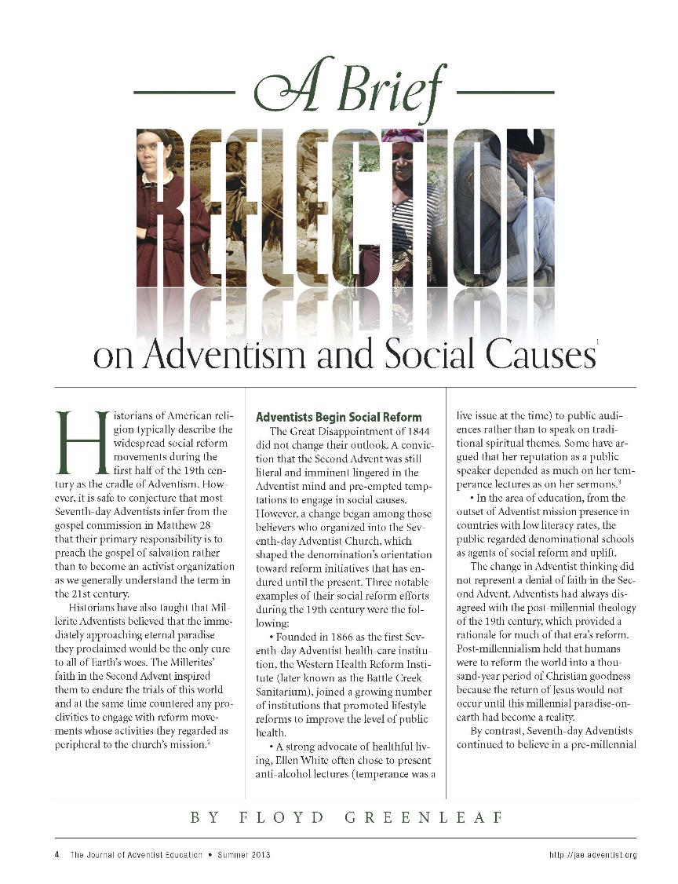

Slide 25
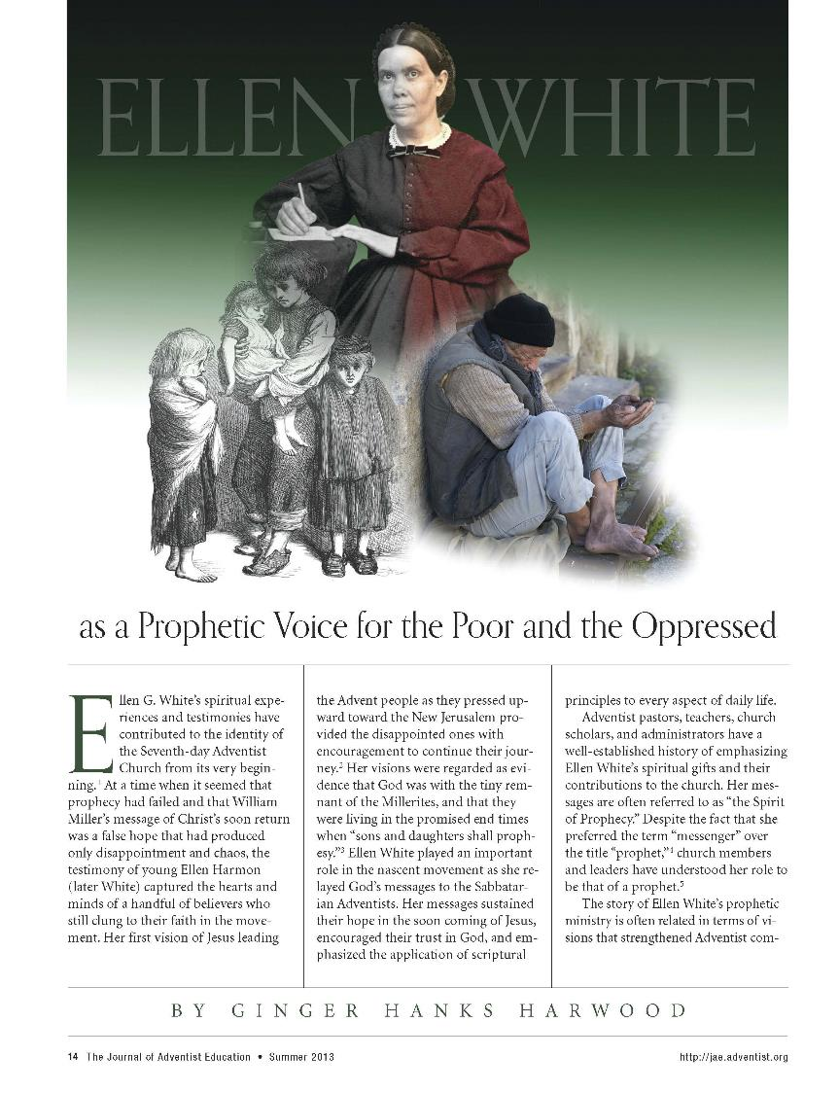

Slide 26
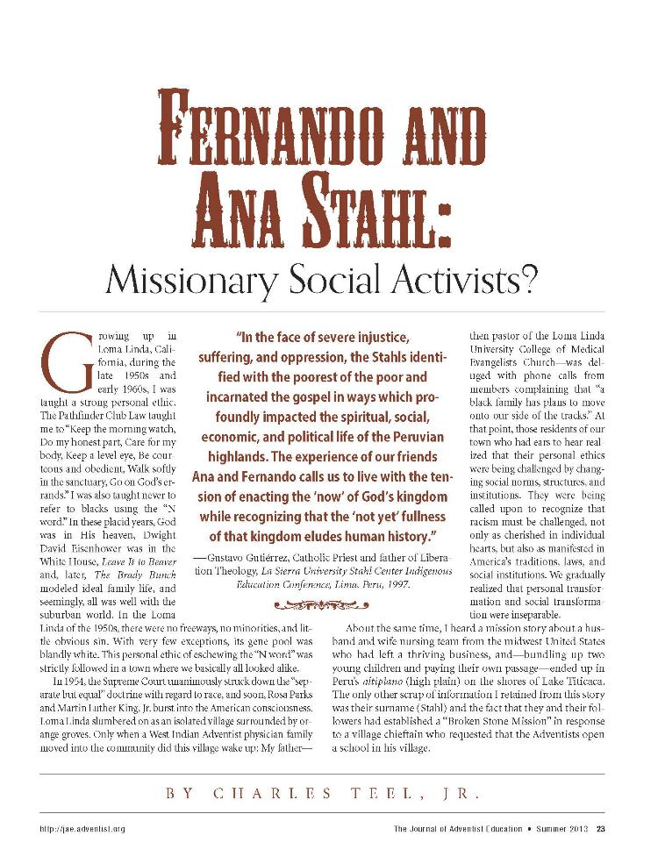

Slide 27
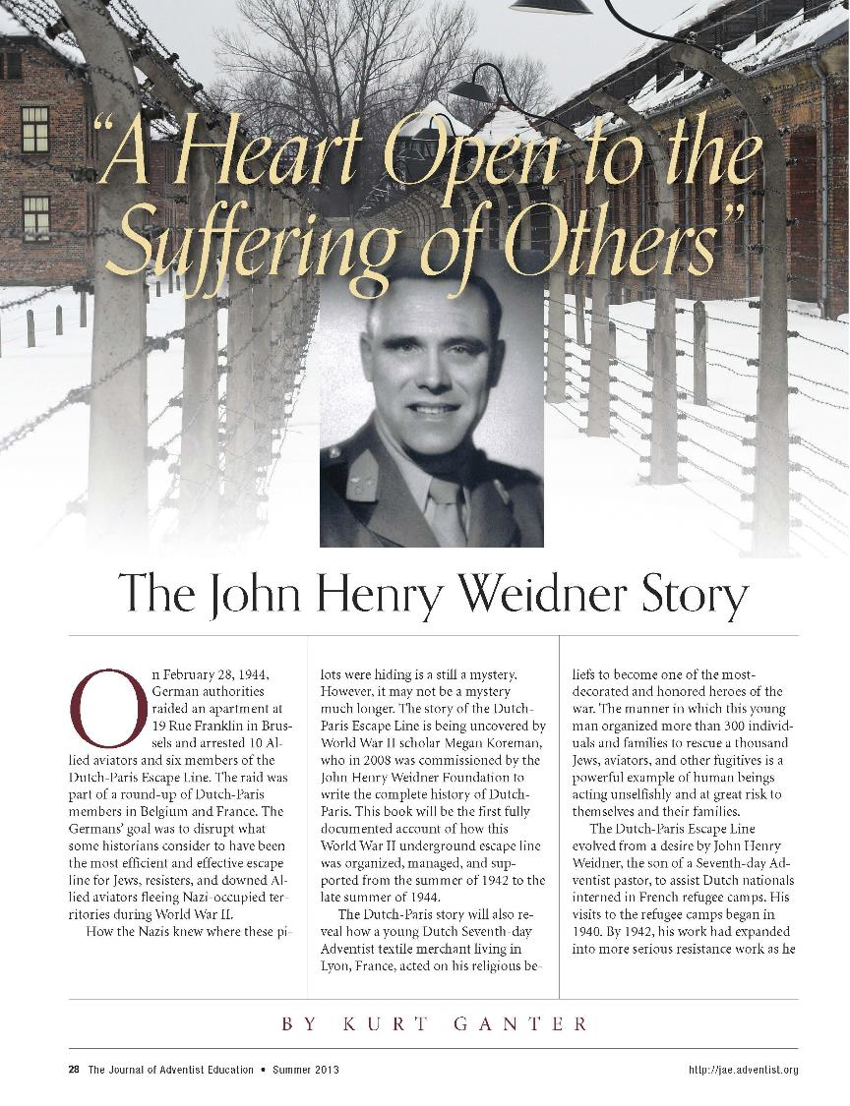

Slide 28
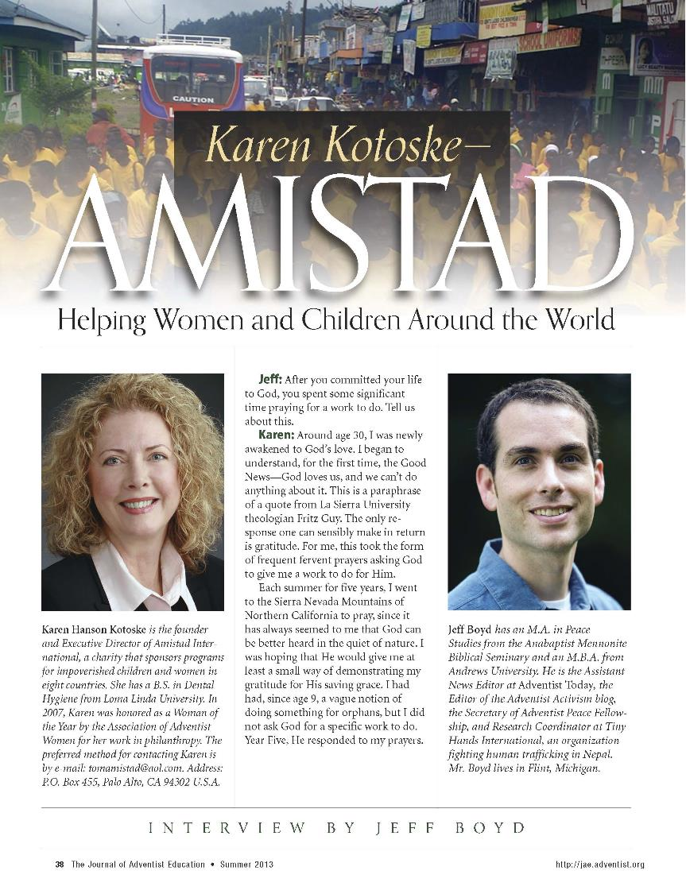

Slide 29
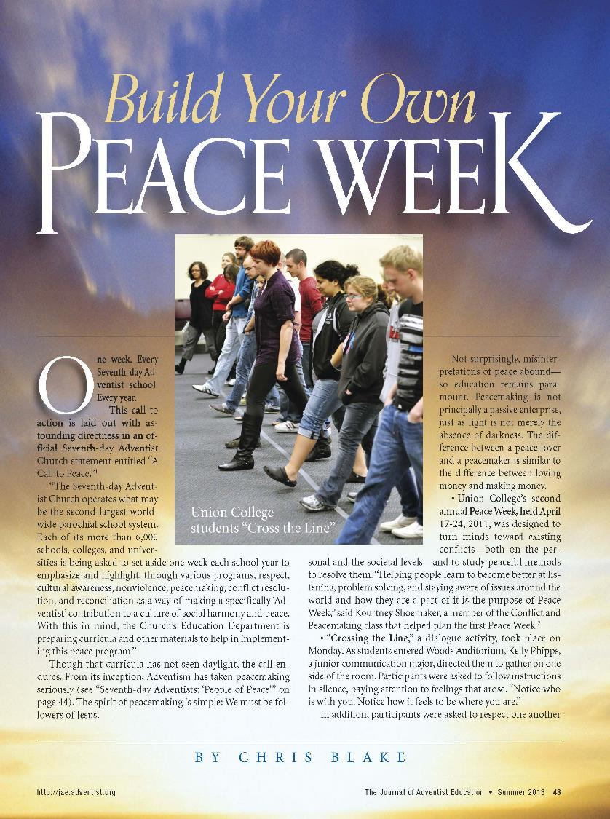

Slide 30
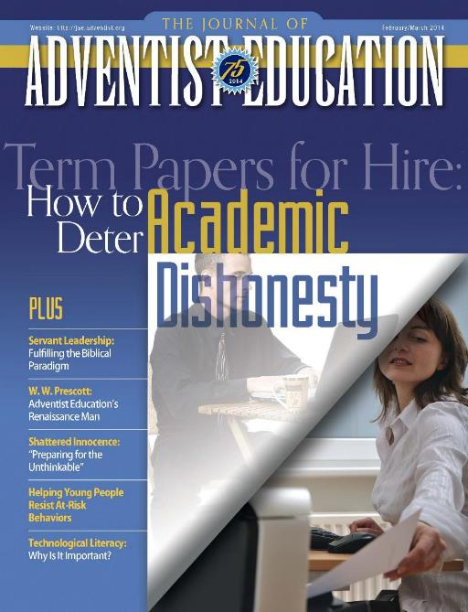

Slide 32
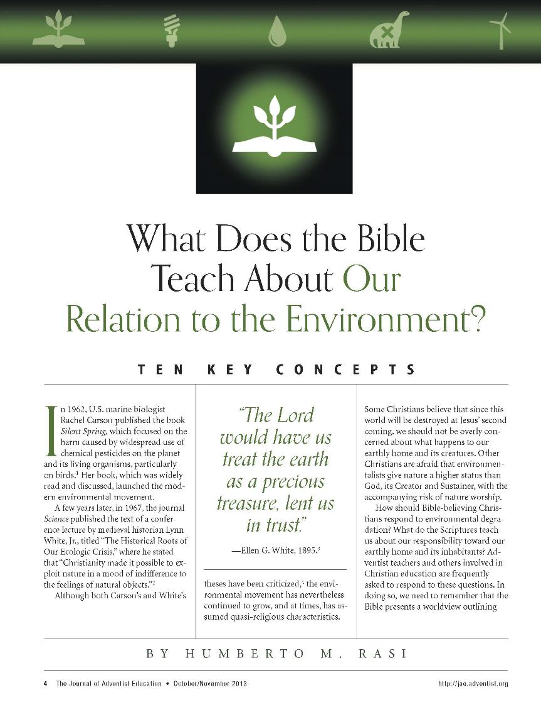

Slide 33
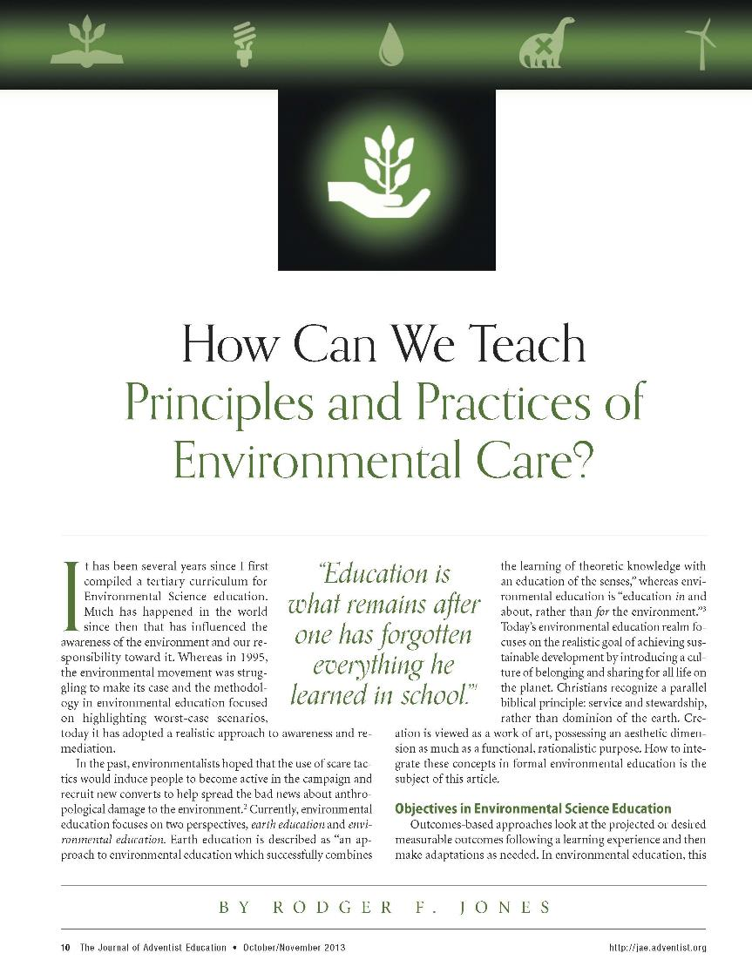

Slide 34
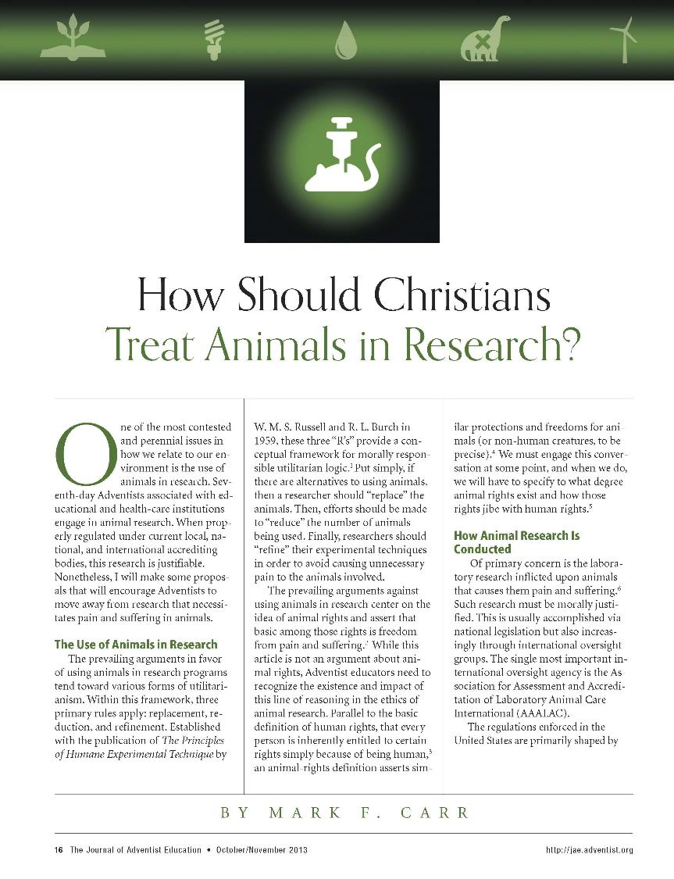

Slide 35
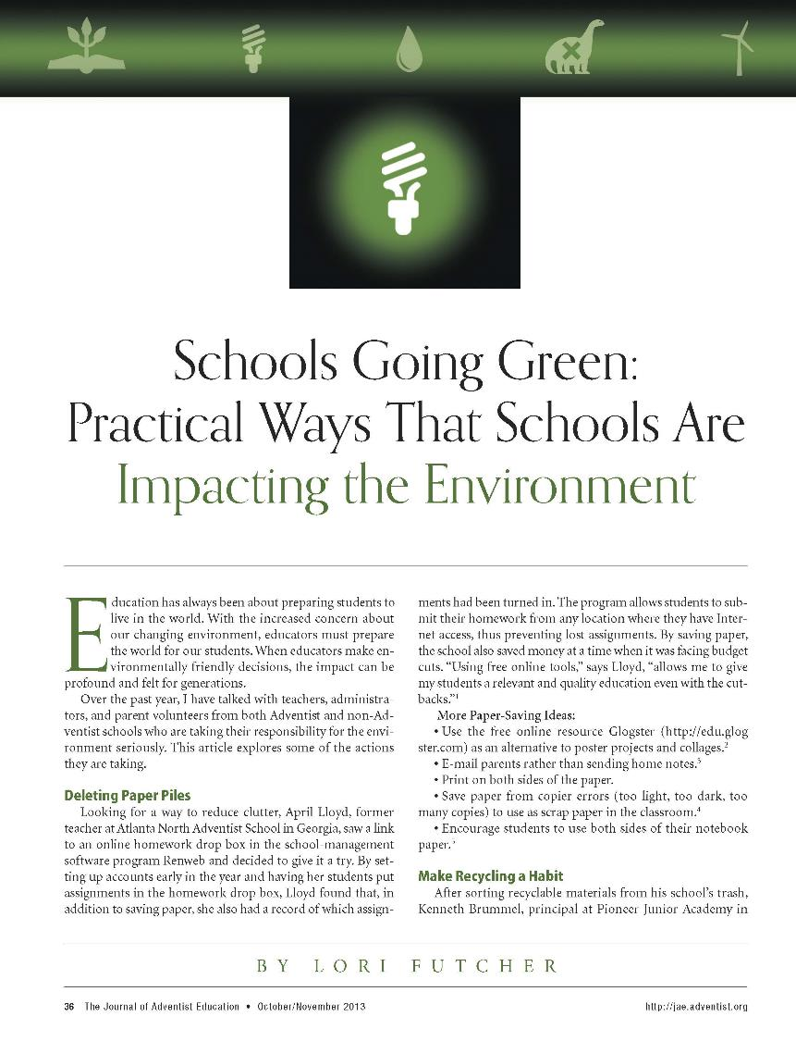

Slide 37
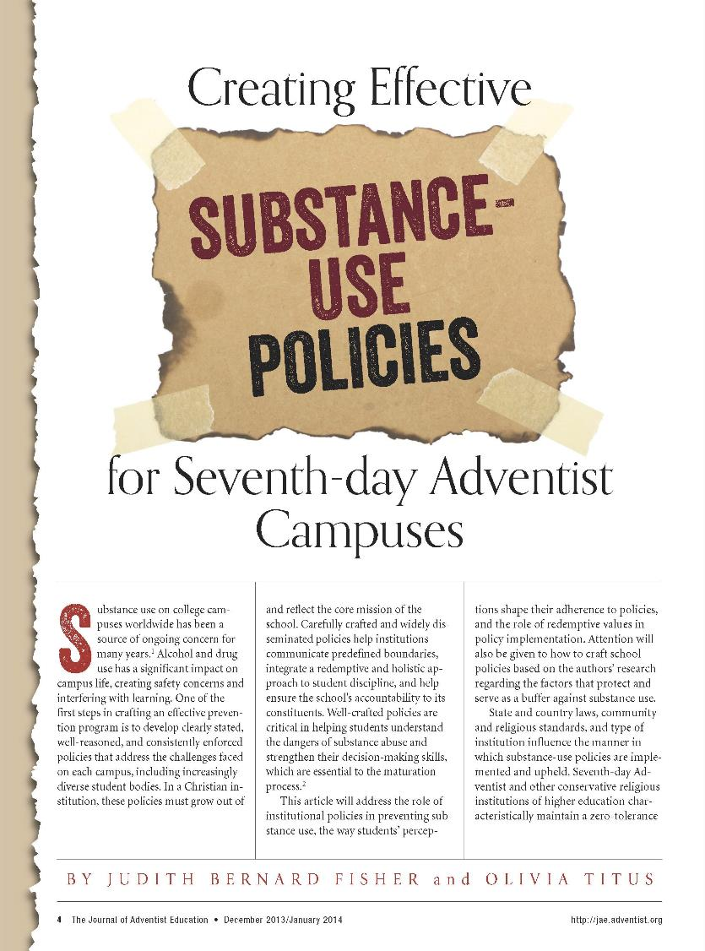

Slide 38
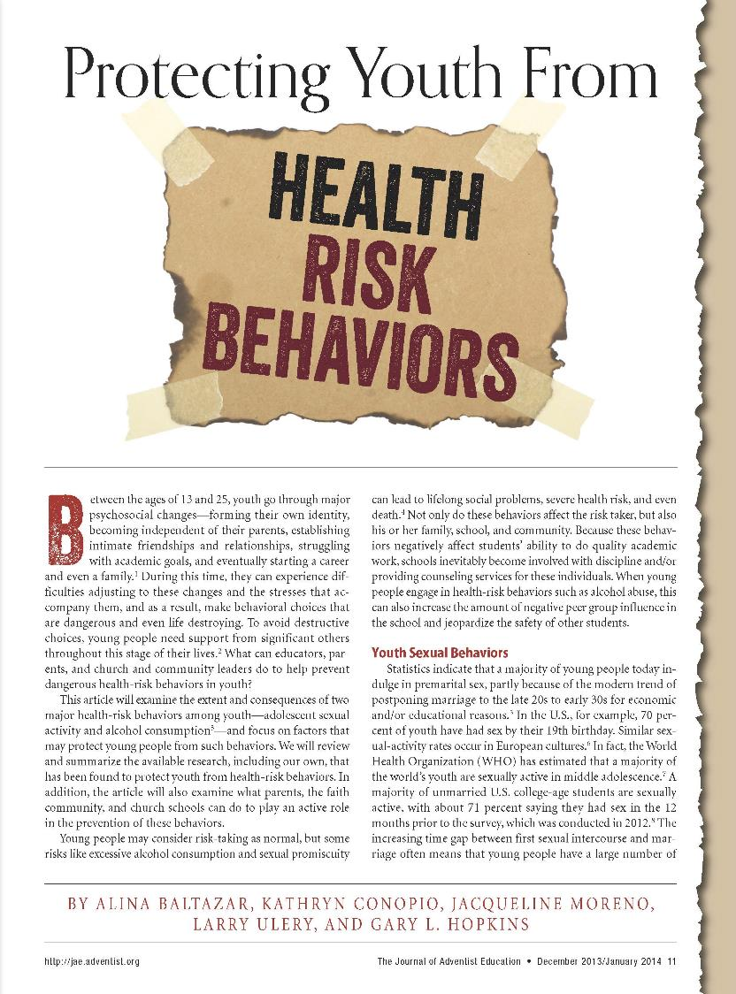

Slide 40
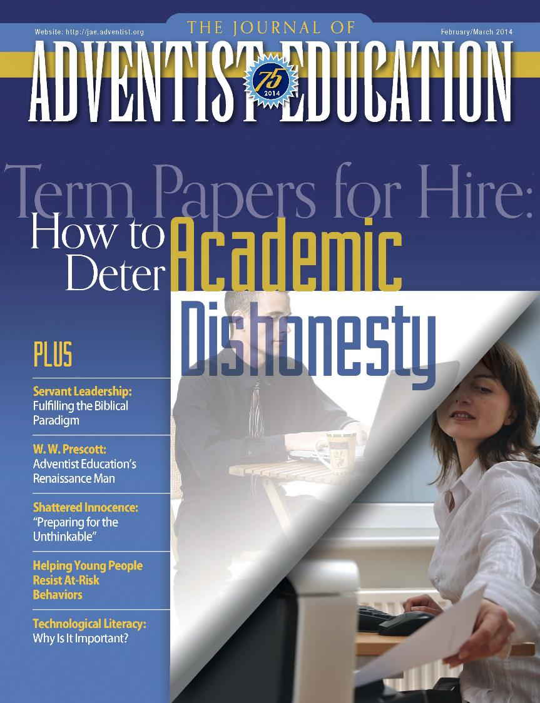

Slide 41
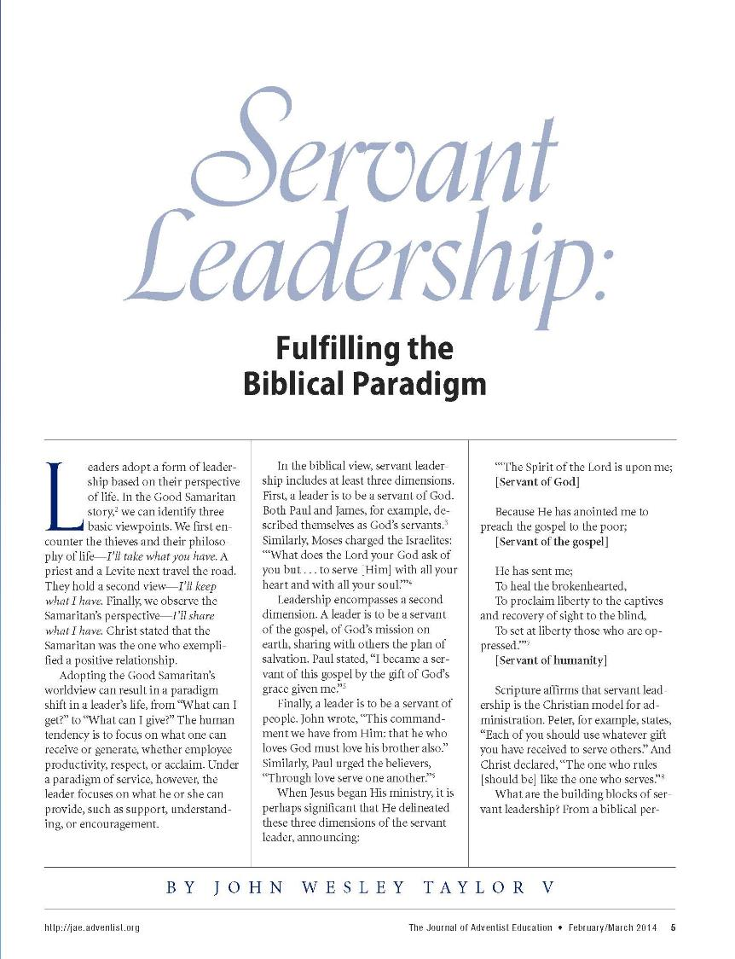

Slide 42
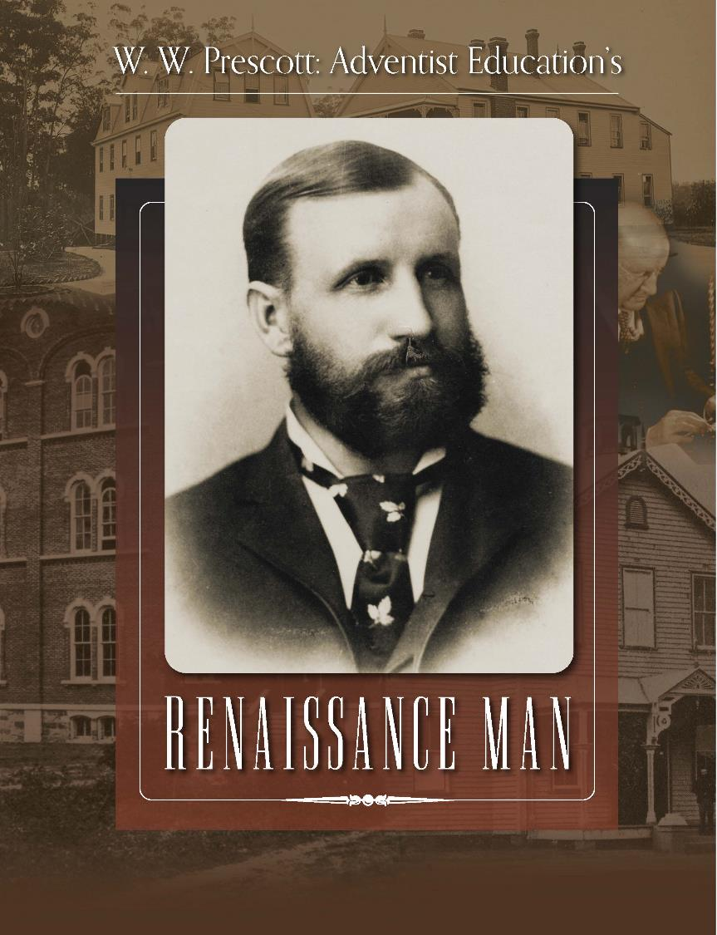

Slide 44
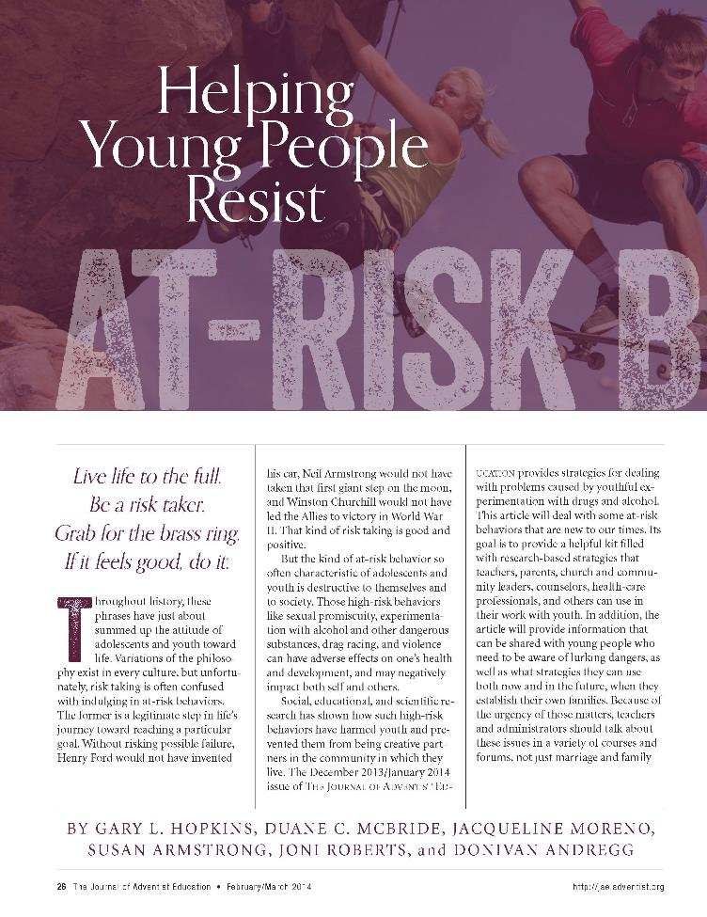

Slide 45
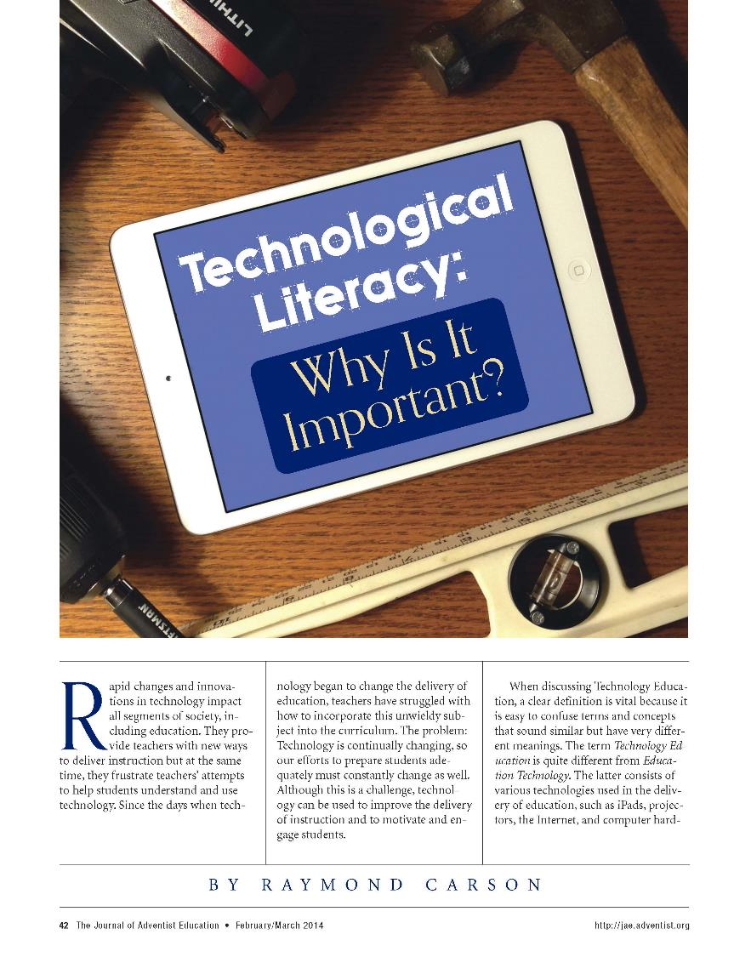

Slide 46
International Editions
French
Portuguese
Spanish

Slide 49
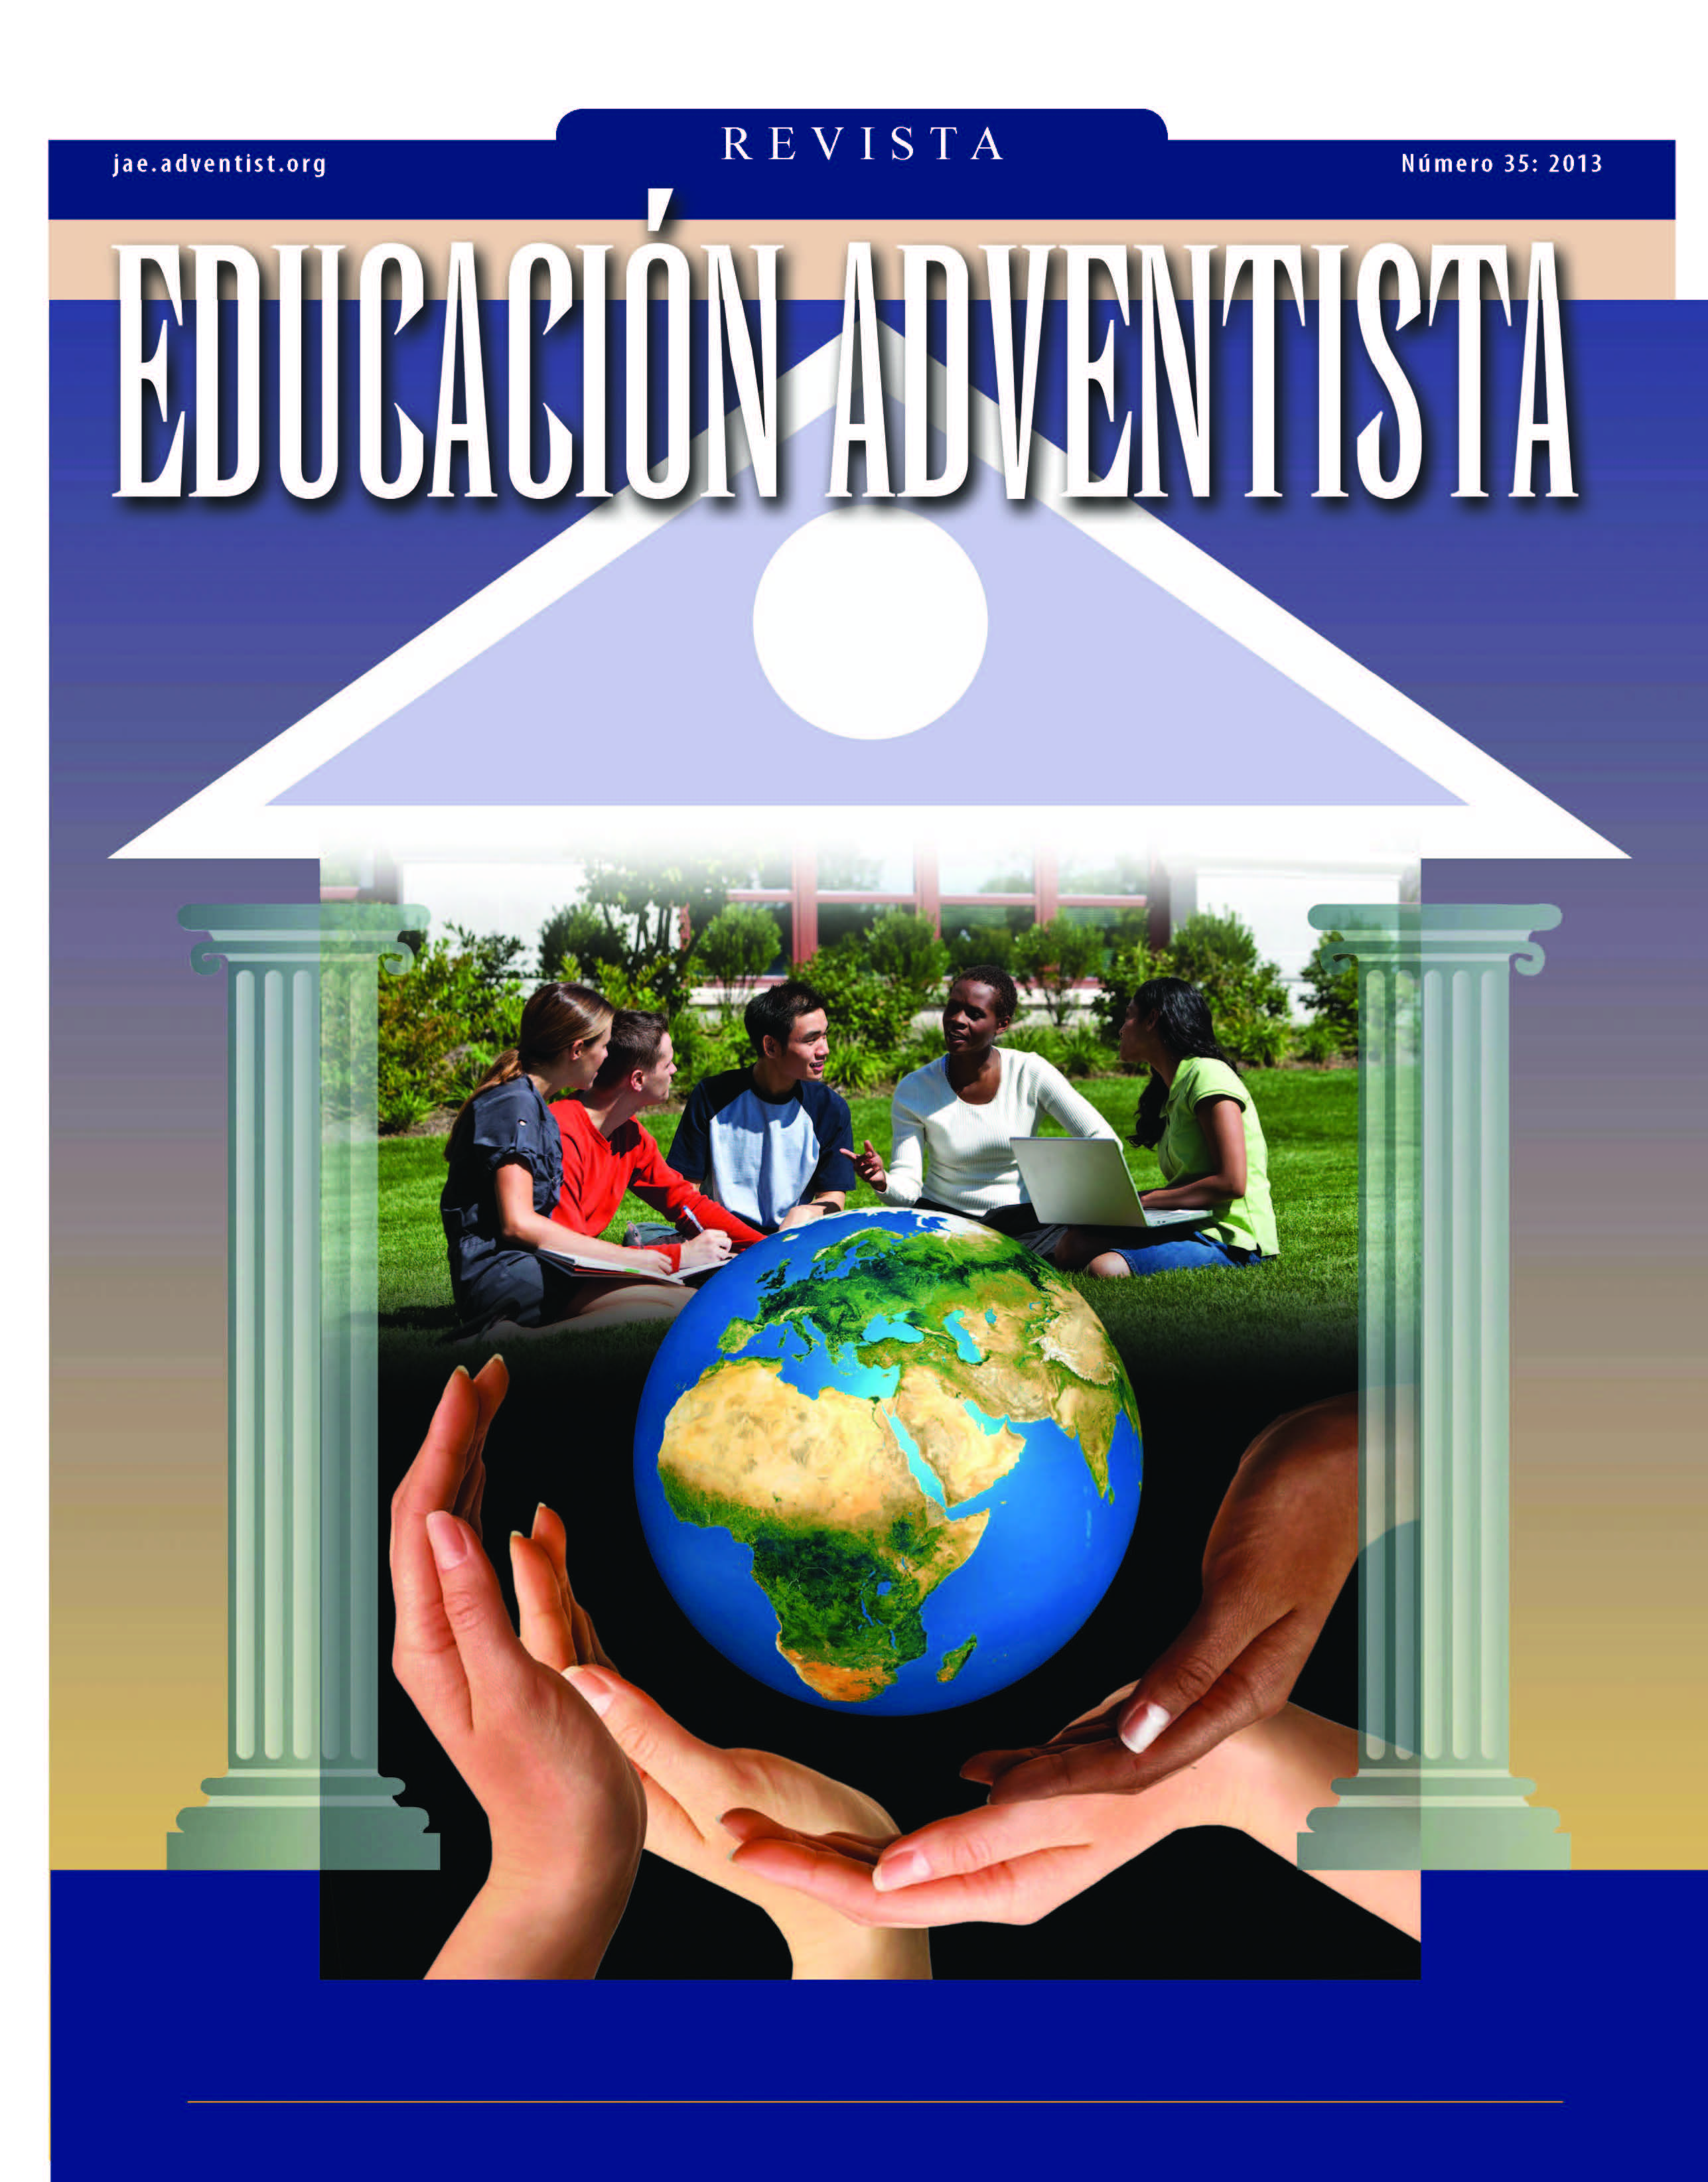

Slide 50
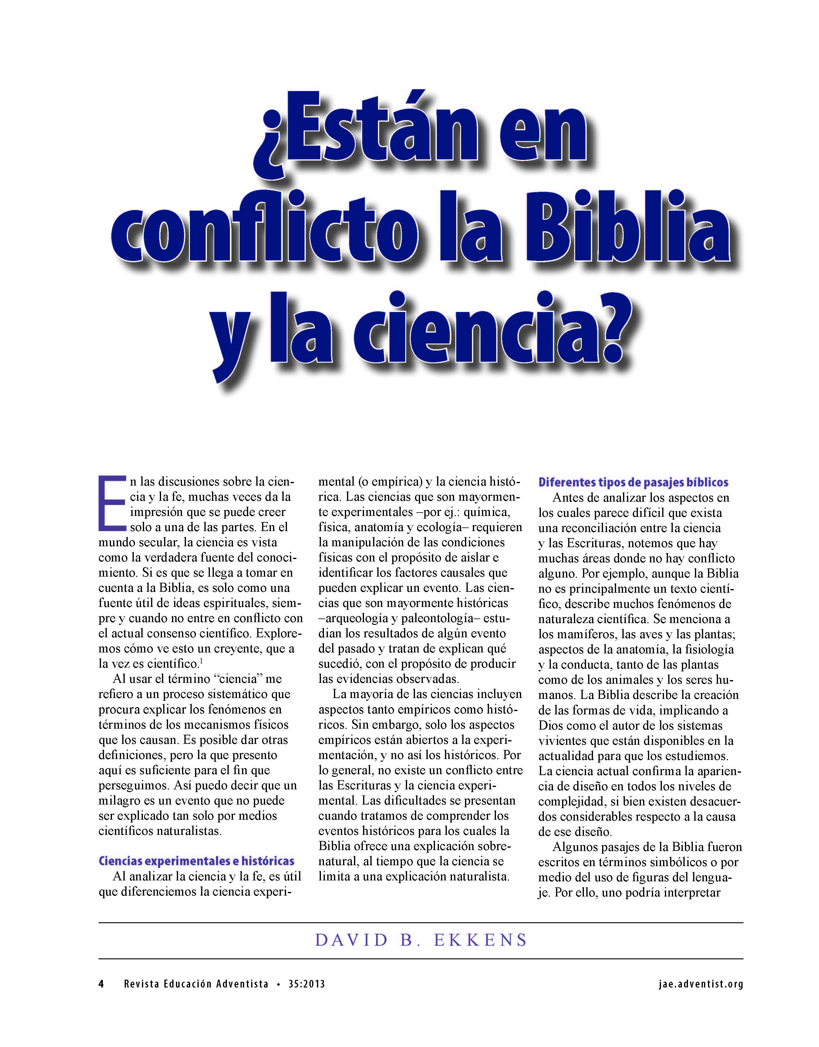

Slide 51
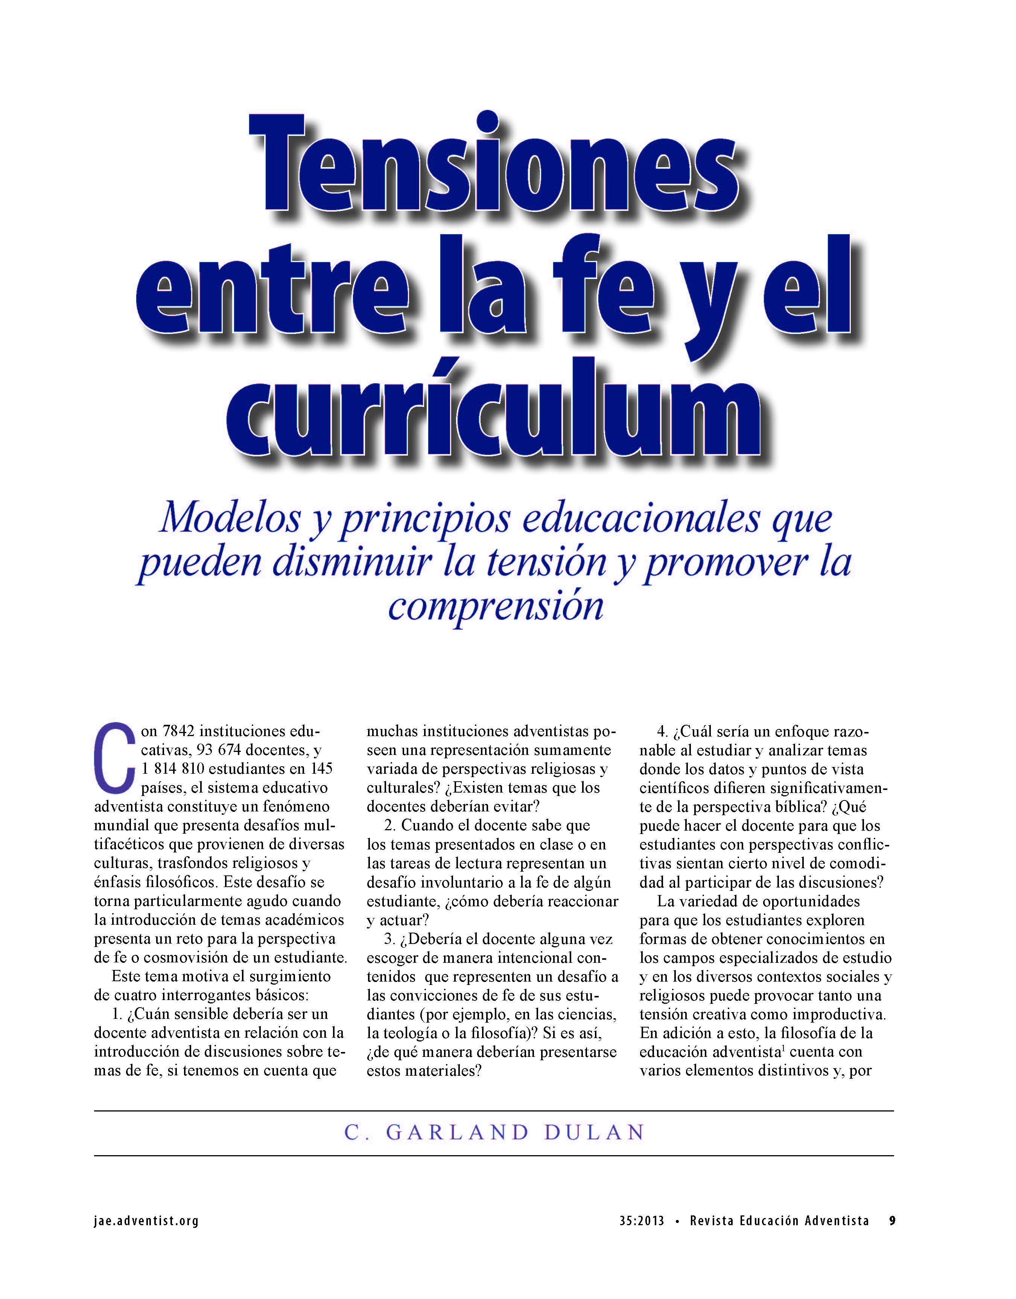

Slide 52
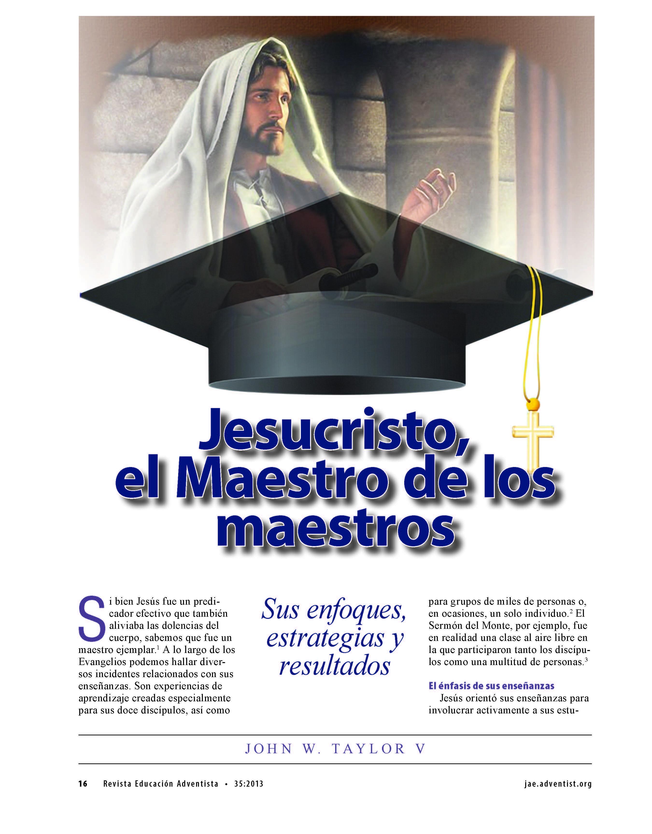

Slide 53
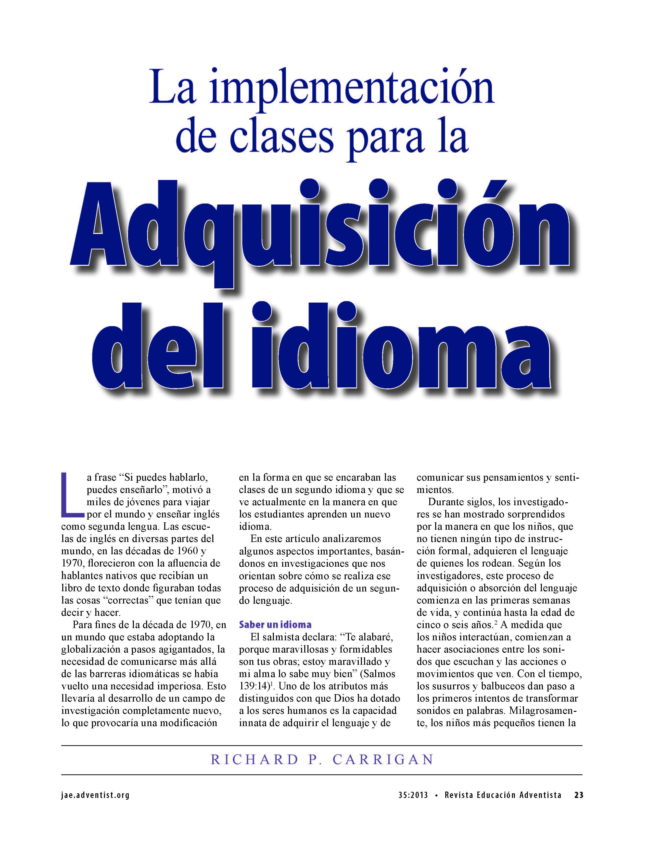

Slide 55
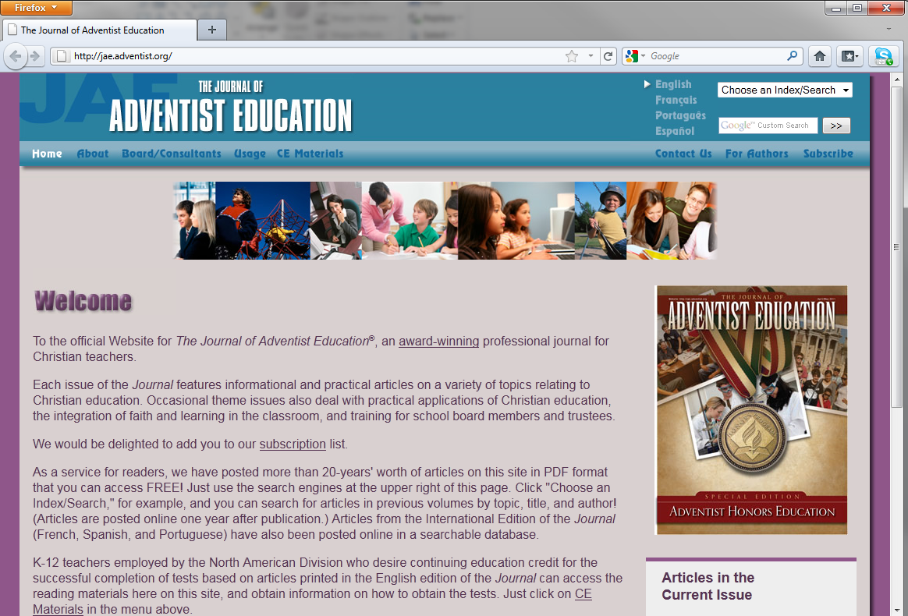
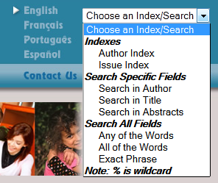
Website: jae.adventist.org

Slide 56
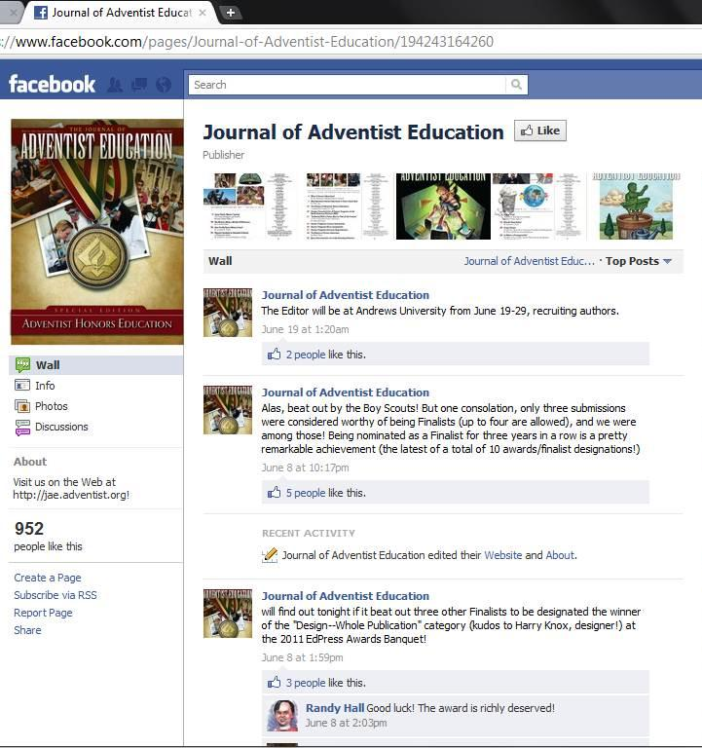
Facebook: 1361 likes

Slide 57
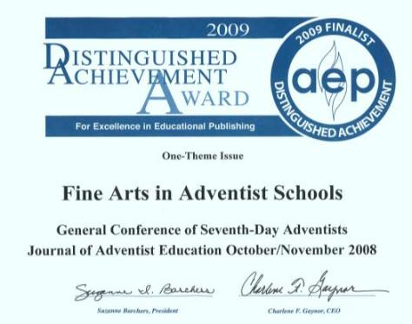
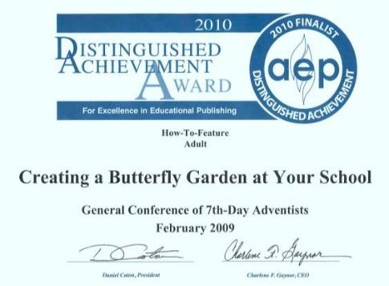
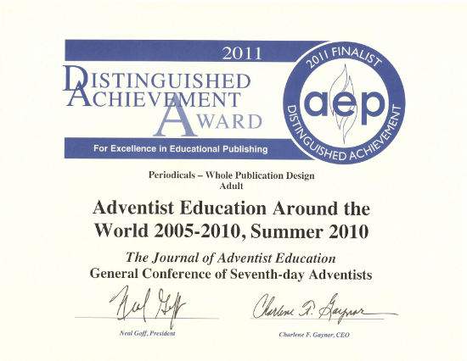
Awards
The Journal of Adventist Education has received 8 Distinguished Achievement Awards and 5 Finalist designations from the Association of American Publishers

Slide 58
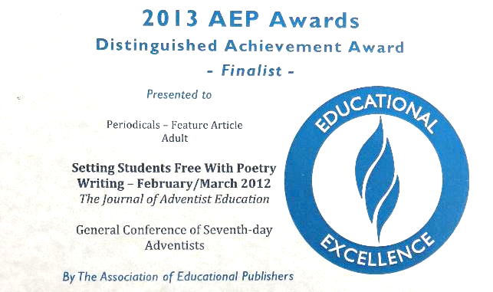
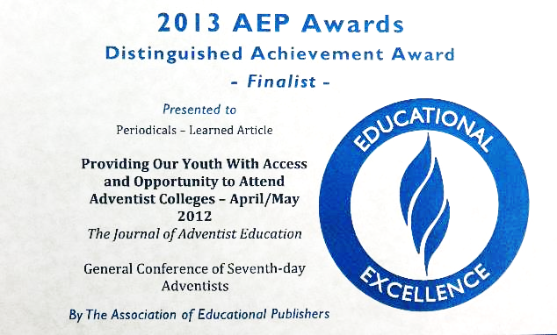
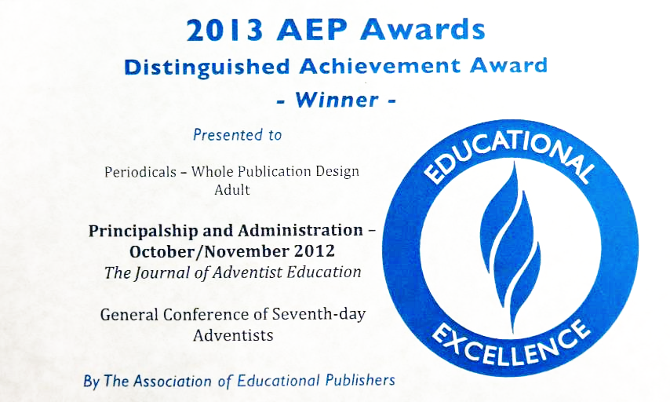
Awards

Slide 59
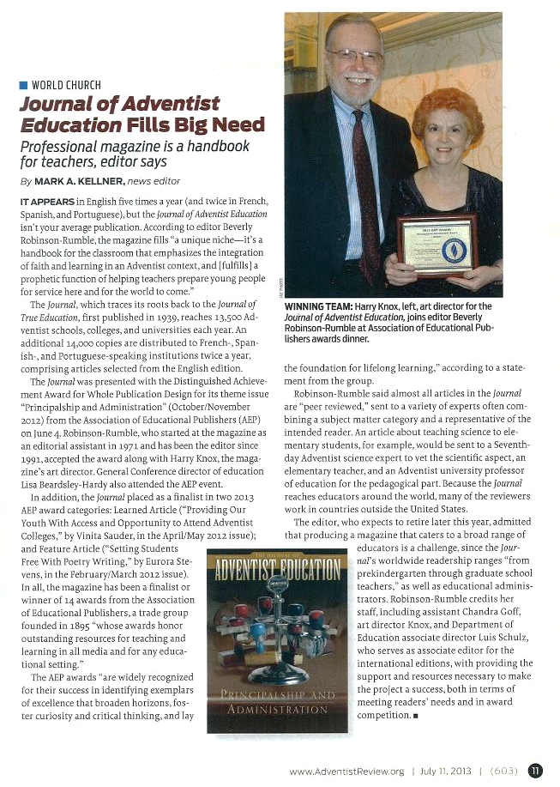
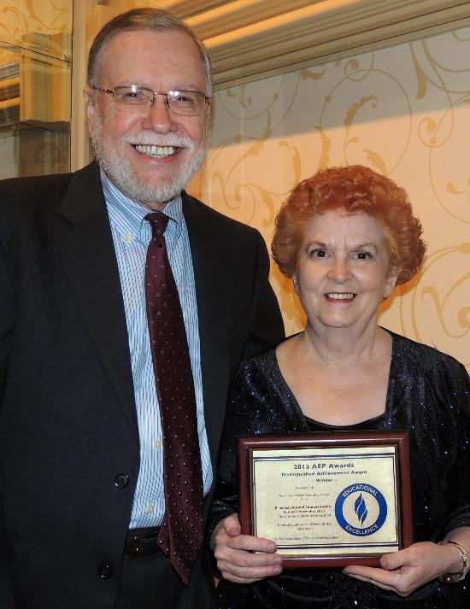
Awards

Slide 60
Annual Council Action
“To request employing organizations (conference, academies, colleges, and universities) to provide the Journal of Adventist Education for all teachers at all levels.” Action 1976-400

Slide 61
Circulation
21,435
2011

Slide 62
Circulation
36,500
+70%
2014

Slide 63
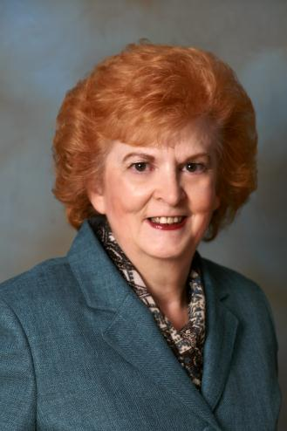
Beverly Rumble, Editor
Joined The Journal of Adventist Education September, 1971
Editor since January 1, 1991
A legacy of 43 years!

Slide 64
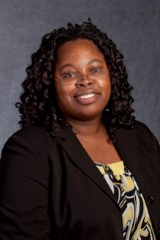
Faith-Ann McGarrell, Incoming Editor
Associate Professor of Teaching, Learning, and Curriculum, Andrews University
PhD in Curriculum & Instruction
MA in English Literature
Taught English/language arts: Grades 7-12

